Slide 1


Boundless Lecture Slides
Available on the Boundless Teaching Platform
Free to share, print, make copies and changes. Get yours at www.boundless.com

Slide 2



Using Boundless Presentations
Boundless Teaching Platform
Boundless empowers educators to engage their students with affordable, customizable textbooks and intuitive teaching tools. The free Boundless Teaching Platform gives educators the ability to customize textbooks in more than 20 subjects that align to hundreds of popular titles. Get started by using high quality Boundless books, or make switching to our platform easier by building from Boundless content pre-organized to match the assigned textbook. This platform gives educators the tools they need to assign readings and assessments, monitor student activity, and lead their classes with pre-made teaching resources.
Get started now at:
The Appendix
The appendix is for you to use to add depth and breadth to your lectures. You can simply drag and drop slides from the appendix into the main presentation to make for a richer lecture experience.
http://boundless.com/teaching-platform
Free to edit, share, and copy
Feel free to edit, share, and make as many copies of the Boundless presentations as you like. We encourage you to take these presentations and make them your own.
If you have any questions or problems please email:
educators@boundless.com
Free to share, print, make copies and changes. Get yours at www.boundless.com

Slide 3

About Boundless
Boundless is an innovative technology company making education more affordable and accessible for students everywhere. The company creates the world’s best open educational content in 20+ subjects that align to more than 1,000 popular college textbooks. Boundless integrates learning technology into all its premium books to help students study more efficiently at a fraction of the cost of traditional textbooks. The company also empowers educators to engage their students more effectively through customizable books and intuitive teaching tools as part of the Boundless Teaching Platform. More than 2 million learners access Boundless free and premium content each month across the company’s wide distribution platforms, including its website, iOS apps, Kindle books, and iBooks. To get started learning or teaching with Boundless, visit boundless.com.
Free to share, print, make copies and changes. Get yours at www.boundless.com

Slide 4
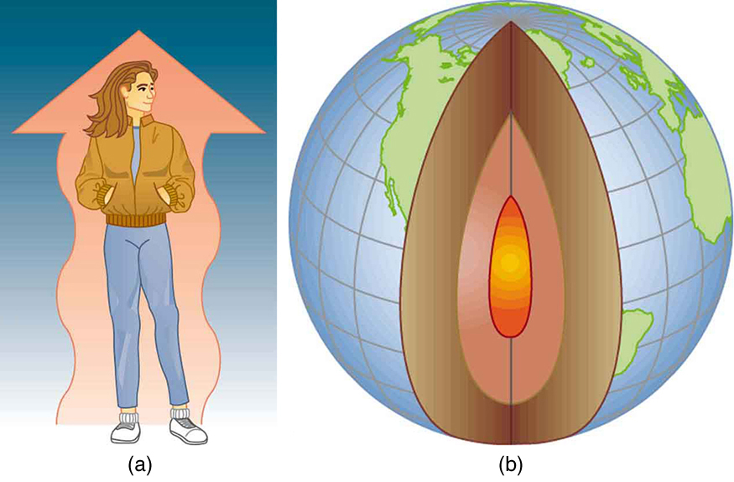

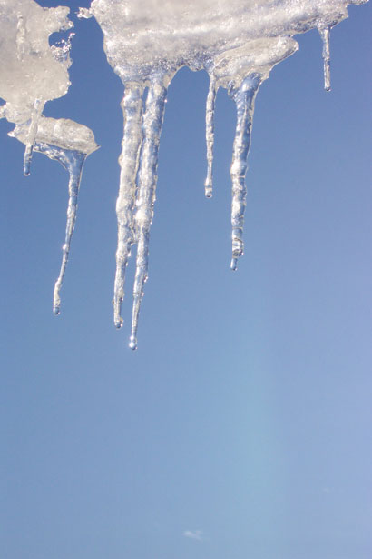
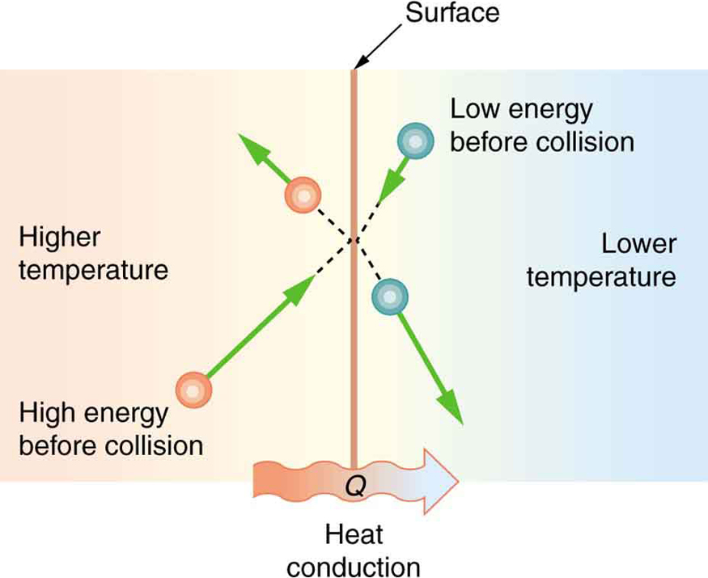
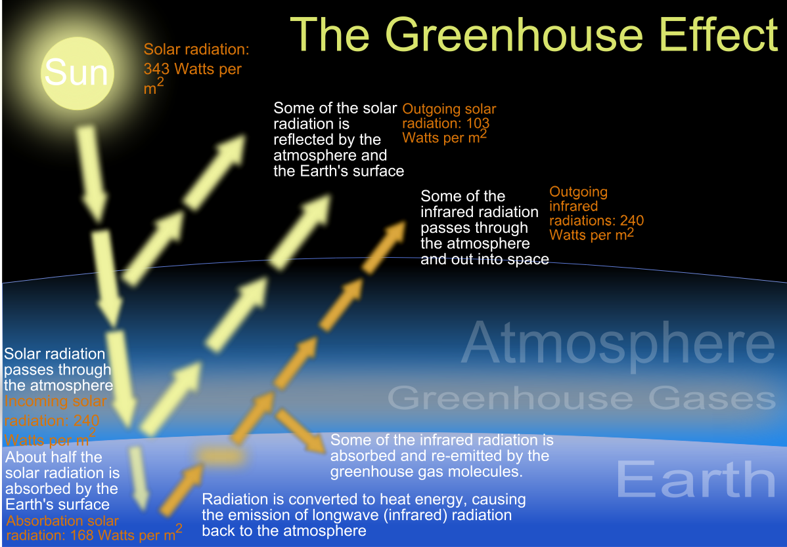
Heat and Heat Transfer
Introduction
Specific Heat
Phase Change and Latent Heat
Methods of Heat Transfer
]
Global Warming
Heat and Heat Transfer
Free to share, print, make copies and changes. Get yours at www.boundless.com

Slide 5
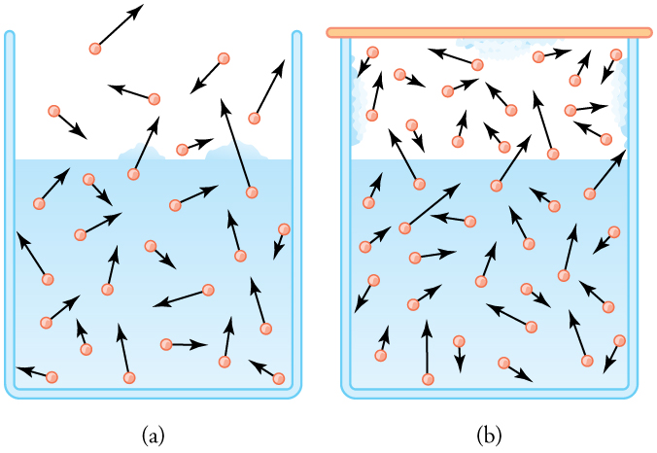
Heat and Heat Transfer (continued)
Phase Equilbrium
]
Heat and Heat Transfer
Free to share, print, make copies and changes. Get yours at www.boundless.com

Slide 6

Introduction
Heat and Heat Transfer > Introduction
Overview of Heat
Heat as Energy Transfer
Internal Energy
Free to share, print, make copies and changes. Get yours at www.boundless.com
www.boundless.com/physics/textbooks/boundless-physics-textbook/heat-and-heat-transfer-13/introduction-110/

Slide 7
Specific Heat
Heat and Heat Transfer > Specific Heat
Heat Capacity
Specific Heat
Calorimetry
Specific Heat for an Ideal Gas at Constant Pressure and Volume
Solving Problems with Calorimetry
Free to share, print, make copies and changes. Get yours at www.boundless.com
www.boundless.com/physics/textbooks/boundless-physics-textbook/heat-and-heat-transfer-13/specific-heat-111/

Slide 8
Phase Change and Latent Heat
Heat and Heat Transfer > Phase Change and Latent Heat
Latent Heat
Free to share, print, make copies and changes. Get yours at www.boundless.com
www.boundless.com/physics/textbooks/boundless-physics-textbook/heat-and-heat-transfer-13/phase-change-and-latent-heat-112/

Slide 9
Methods of Heat Transfer
Heat and Heat Transfer > Methods of Heat Transfer
Conduction
Convection
Radiation
Free to share, print, make copies and changes. Get yours at www.boundless.com
www.boundless.com/physics/textbooks/boundless-physics-textbook/heat-and-heat-transfer-13/methods-of-heat-transfer-113/

Slide 10
Global Warming
Heat and Heat Transfer > Global Warming
Greenhouse Gases and Global Warming
Free to share, print, make copies and changes. Get yours at www.boundless.com
www.boundless.com/physics/textbooks/boundless-physics-textbook/heat-and-heat-transfer-13/global-warming-114/

Slide 11
Phase Equilbrium
Heat and Heat Transfer > Phase Equilbrium
Evaporation
The Evaporating Atmosphere
Free to share, print, make copies and changes. Get yours at www.boundless.com
www.boundless.com/physics/textbooks/boundless-physics-textbook/heat-and-heat-transfer-13/phase-equilbrium-115/

Slide 12
Appendix
Free to share, print, make copies and changes. Get yours at www.boundless.com

Slide 13
Key terms
Heat and Heat Transfer
adiabatic index The ratio of the heat capacity at constant pressure to heat capacity at constant volume.
blackbody A theoretical body, approximated by a hole in a hollow black sphere, that absorbs all incident electromagnetic radiation and reflects none; it has a characteristic emission spectrum.
blackbody An object that is a perfect absorber and emitter of radiation.
calorimeter An apparatus for measuring the heat generated or absorbed by either a chemical reaction, change of phase or some other physical change.
calorimetry The science of measuring the heat absorbed or evolved during the course of a chemical reaction or change of state.
combustion A process where two chemicals are combined to produce heat.
condensation The conversion of a gas to a liquid; the condensate so formed
constant-pressure calorimeter An instrument used to measure the heat generated during changes that do not involve changes in pressure.
constant-volume calorimeter An instrument used to measure the heat generated during changes that do not involve changes in volume.
emissivity The energy-emitting propensity of a surface, usually measured at a specific wavelength.
enthalpy the total amount of energy in a system, including both the internal energy and the energy needed to displace its environment
equilibrium The state of a body at rest or in uniform motion, the resultant of all forces on which is zero.
Free to share, print, make copies and changes. Get yours at www.boundless.com

Slide 14
Heat and Heat Transfer
Evaporation The process of a liquid converting to the gaseous state.
Fundamental Thermodynamic Relation In thermodynamics, the fundamental thermodynamic relation expresses an infinitesimal change in internal energy in terms of infinitesimal changes in entropy, and volume for a closed system in thermal equilibrium in the following way: dU=TdS-PdV. Here, U is internal energy, T is absolute temperature, S is entropy, P is pressure and V is volume.
greenhouse effect The process by which a planet is warmed by its atmosphere.
greenhouse gas Any gas, such as carbon dioxide or CFCs, that contributes to the greenhouse effect when released into the atmosphere.
heat capacity The amount of heat energy needed to raise the temperature of an object or unit of matter by one degree Celsius; in units of joules per kelvin (J/K).
heat of reaction The enthalpy change in a chemical reaction; the amount of heat that a systems gives up to its surroundings so it can return to its initial temperature.
heat transfer The transmission of thermal energy via conduction, convection, or radiation.
internal energy The sum of all energy present in the system, including kinetic and potential energy; equivalently, the energy needed to create a system, excluding the energy necessary to displace its surroundings.
isolated system A system that does not interact with its surroundings, that is, its total energy and mass stay constant.
kilocalorie A non-SI unit of energy equal to 1,000 calories or 4,186 joules; equal to the "calorie" or "Calorie" used in nutritional labeling. Symbol: kcal.
latent heat of fusion the energy required to transition one unit of a substance from solid to liquid; equivalently, the energy liberated when one unit of a substance transitions from liquid to solid.
latent heat of vaporization the energy required to transition one unit of a substance from liquid to vapor; equivalently, the energy liberated when one unit of a substance transitions from vapor to liquid.
Free to share, print, make copies and changes. Get yours at www.boundless.com

Slide 15
Heat and Heat Transfer
mechanical equivalent of heat The work needed to produce the same effects as heat transfer.
natural convection A method for heat transport. A fluid surrounding a heat source receives heat, becomes less dense and rises. The surrounding, cooler fluid then moves to replace it. This cooler fluid is then heated and the process continues, forming a convection current.
positive feedback a feedback loop in which the output of a system is amplified with a net positive gain each cycle.
radiative transfer The transfer of radiation (energy) leaving one object and being absorbed by another.
selective absorber An object that will absorb radiation over a particular set of wavelengths but will not (is transparent) at other wavelengths.
specific heat The ratio of the amount of heat needed to raise the temperature of a unit mass of substance by a unit degree to the amount of heat needed to raise that of the same mass of water by the same amount.
specific heat capacity The amount of heat that must be added (or removed) from a unit mass of a substance to change its temperature by one degree Celsius. It is an intensive property.
sublimation the transition of a substance from the solid phase directly to the vapor state such that it does not pass through the intermediate, liquid phase
thermal conductivity the measure of a material's ability to conduct heat
thermal equilibrium Two systems are in thermal equilibrium if they could transfer heat between each other, but don't.
Vaporization a conversion of a solid or a liquid into a gas
Free to share, print, make copies and changes. Get yours at www.boundless.com

Slide 16
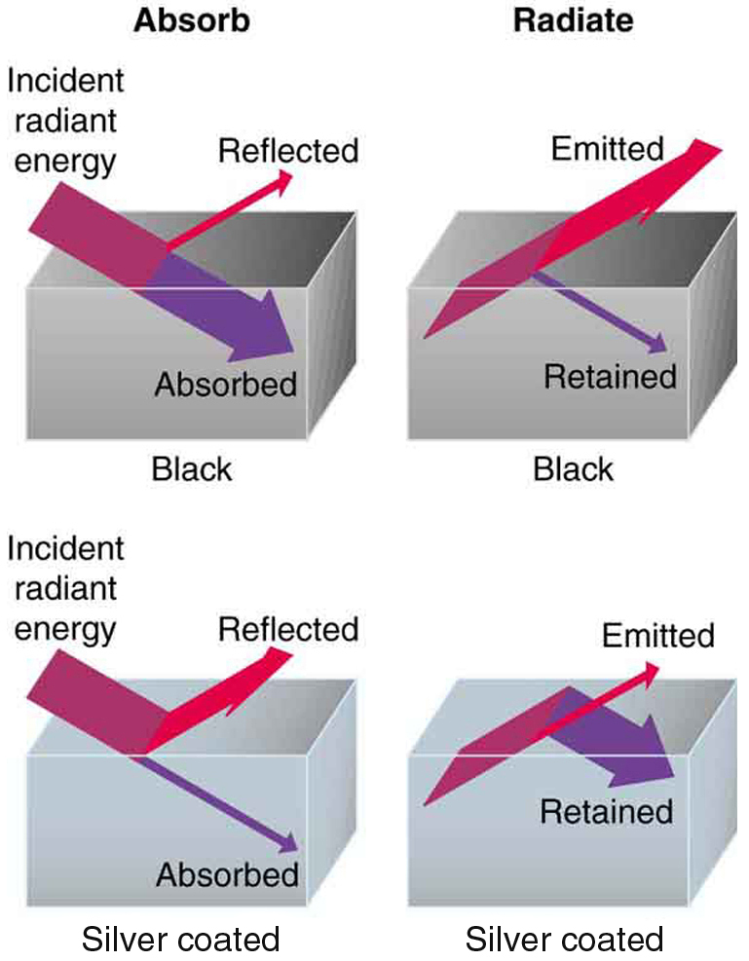

Heat and Heat Transfer
Good and Poor Radiators
A black object is a good absorber and a good radiator, while a white (or silver) object is a poor absorber and a poor radiator. It is as if radiation from the inside is reflected back into the silver object, whereas radiation from the inside of the black object is "absorbed" when it hits the surface and finds itself on the outside and is strongly emitted.
Free to share, print, make copies and changes. Get yours at www.boundless.com
OpenStax CNX. "OpenStax College, College Physics. October 15, 2012." CC BY 3.0 http://cnx.org/content/m42230/latest/?collection=col11406/1.7 View on Boundless.com

Slide 17
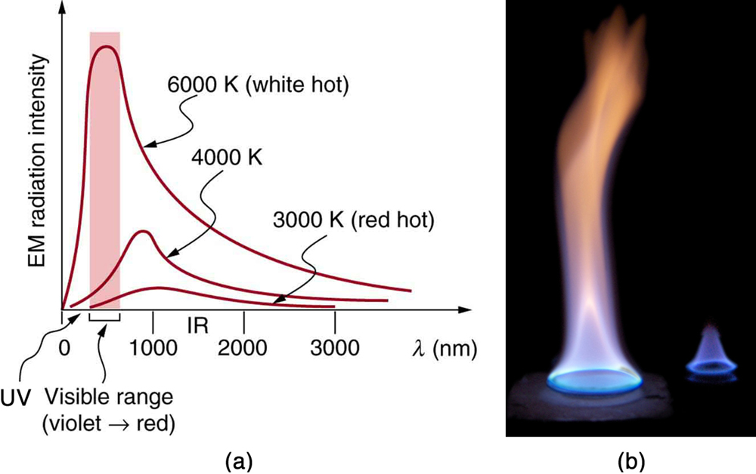
Heat and Heat Transfer
Radiation Spectrum
(a) A graph of the spectra of electromagnetic waves emitted from an ideal radiator at three different temperatures. The intensity or rate of radiation emission increases dramatically with temperature, and the spectrum shifts toward the visible and ultraviolet parts of the spectrum. The shaded portion denotes the visible part of the spectrum. It is apparent that the shift toward the ultraviolet with temperature makes the visible appearance shift from red to white to blue as temperature increases. (b) Note the variations in color corresponding to variations in flame temperature.
Free to share, print, make copies and changes. Get yours at www.boundless.com
OpenStax CNX. "OpenStax College, College Physics. October 15, 2012." CC BY 3.0 http://cnx.org/content/m42230/latest/?collection=col11406/1.7 View on Boundless.com

Slide 18
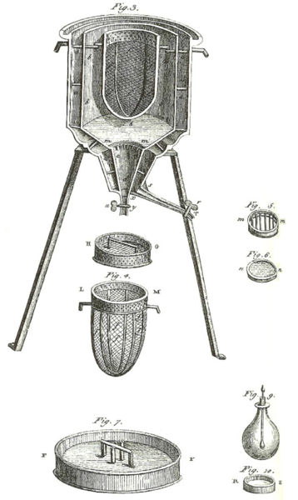
Heat and Heat Transfer
Ice Calorimeter
The world's first ice-calorimeter, used in the winter of 1782-83, by Antoine Lavoisier and Pierre-Simon Laplace, to determine the heat evolved in variouschemical changes; calculations which were based on Joseph Black's prior discovery of latent heat. These experiments mark the foundation of thermochemistry.
Free to share, print, make copies and changes. Get yours at www.boundless.com
Wikipedia. "Calorimetry." GNU FDL http://en.wikipedia.org/wiki/Calorimetry View on Boundless.com

Slide 19
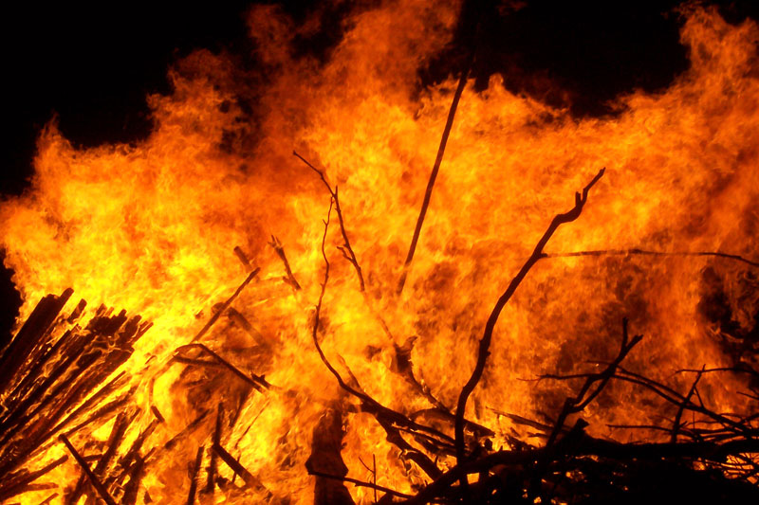
Heat and Heat Transfer
Radiation from a Fire
Most of the heat transfer from this fire to the observers is through infrared radiation. The visible light, although dramatic, transfers relatively little thermal energy. Convection transfers energy away from the observers as hot air rises, while conduction is negligibly slow here. Skin is very sensitive to infrared radiation so that you can sense the presence of a fire without looking at it directly.
Free to share, print, make copies and changes. Get yours at www.boundless.com
Wikipedia. "Fire." GNU FDL http://en.wikipedia.org/wiki/Fire View on Boundless.com

Slide 20
Heat and Heat Transfer
Melting Icicle
Heat from the air transfers to the ice causing it to melt.
Free to share, print, make copies and changes. Get yours at www.boundless.com
Public Domain Pictures. "Icicle Drip Free Stock Photo - Public Domain Pictures." Public domain http://www.publicdomainpictures.net/view-image.php?image=8182&picture=icicle-drip View on Boundless.com

Slide 21
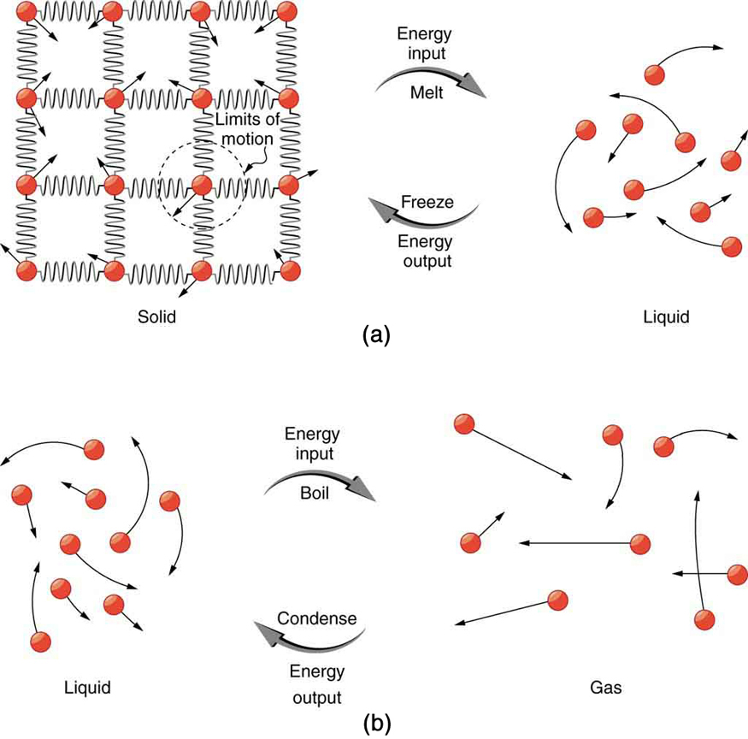
Heat and Heat Transfer
Phase Transitions
(a) Energy is required to partially overcome the attractive forces between molecules in a solid to form a liquid. That same energy must be removed for freezing to take place. (b) Molecules are separated by large distances when going from liquid to vapor, requiring significant energy to overcome molecular attraction. The same energy must be removed for condensation to take place. There is no temperature change until a phase change is complete.
Free to share, print, make copies and changes. Get yours at www.boundless.com
OpenStax CNX. "OpenStax College, College Physics. October 15, 2012." CC BY 3.0 http://cnx.org/content/m42225/latest/?collection=col11406/1.7 View on Boundless.com

Slide 22
Heat and Heat Transfer
Examples of Heat Transfer
(a) The chilling effect of a clear breezy night is produced by the wind and by radiative heat transfer to cold outer space. (b) There was once great controversy about the Earth's age, but it is now generally accepted to be about 4.5 billion years old. Much of the debate is centered on the Earth's molten interior. According to our understanding of heat transfer, if the Earth is really that old, its center should have cooled off long ago. The discovery of radioactivity in rocks revealed the source of energy that keeps the Earth's interior molten, despite heat transfer to the surface, and from there to cold outer space.
Free to share, print, make copies and changes. Get yours at www.boundless.com
OpenStax CNX. "OpenStax College, College Physics. October 15, 2012." CC BY 3.0 http://cnx.org/content/m42221/latest/?collection=col11406/1.7 View on Boundless.com

Slide 23
Heat and Heat Transfer
Vapor Pressure Diagram
(a) Because of the distribution of speeds and kinetic energies, some water molecules can break away to the vapor phase even at temperatures below the ordinary boiling point. (b) If the container is sealed, evaporation will continue until there is enough vapor density for the condensation rate to equal the evaporation rate. This vapor density and the partial pressure it creates are the saturation values. They increase with temperature and are independent of the presence of other gases, such as air. They depend only on the vapor pressure of water.
Free to share, print, make copies and changes. Get yours at www.boundless.com
OpenStax CNX. "OpenStax College, College Physics. November 3, 2012." CC BY 3.0 http://cnx.org/content/m42219/latest/?collection=col11406/1.7 View on Boundless.com

Slide 24
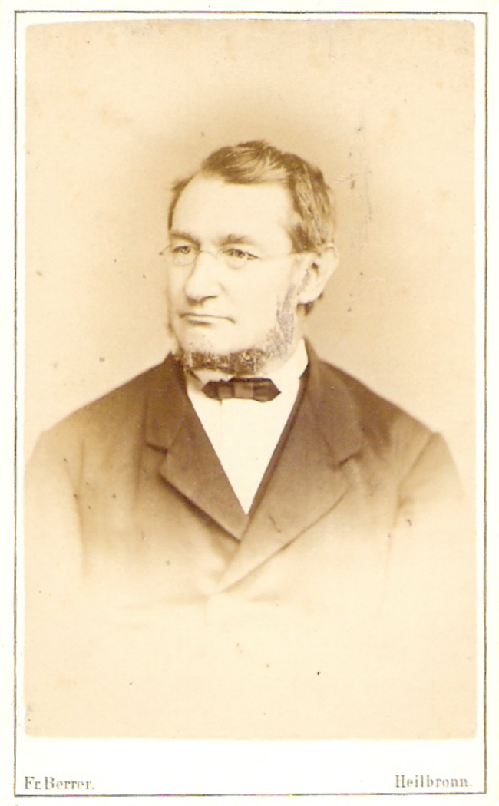
Heat and Heat Transfer
Julius Robert Mayer
Julius Robert von Mayer (November 25, 1814 – March 20, 1878), a German physician and physicist, was one of the founders of thermodynamics. He is best known for his 1841 enunciation of one of the original statements of the conservation of energy (or what is now known as one of the first versions of the first law of thermodynamics): "Energy can be neither created nor destroyed. " In 1842, Mayer described the vital chemical process now referred to as oxidation as the primary source of energy for any living creature. His achievements were overlooked and credit for the discovery of the mechanical equivalent of heat was attributed to James Joule in the following year. von Mayer also proposed that plants convert light into chemical energy.
Free to share, print, make copies and changes. Get yours at www.boundless.com
Wikipedia. "Julius Robert von Mayer." Public domain http://en.wikipedia.org/wiki/Julius_Robert_von_Mayer View on Boundless.com

Slide 25

Heat and Heat Transfer
Water Vapor in the Atmosphere
Water vapor condenses in the atmosphere
Free to share, print, make copies and changes. Get yours at www.boundless.com
Wikipedia. "Water vapour." CC BY http://en.wikipedia.org/wiki/Water_vapour%23Air_and_water_vapor_density_interactions_at_equal_temperatures View on Boundless.com

Slide 26
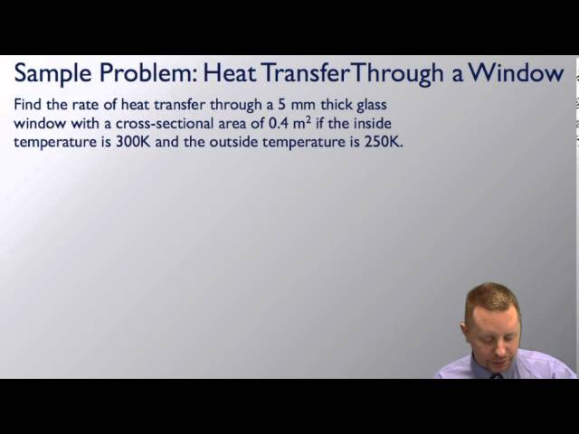
Heat and Heat Transfer
Heat Transfer
A brief introduction to heat transfer for students.
Free to share, print, make copies and changes. Get yours at www.boundless.com
View on Boundless.com

Slide 27
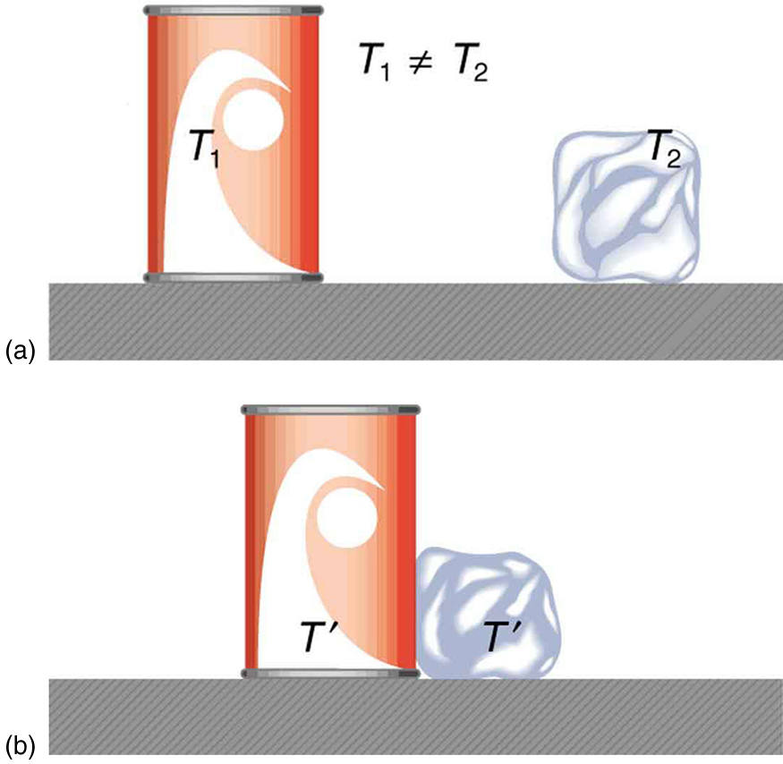
Heat and Heat Transfer
Heat Transfer and Equilibrium
(a) The soft drink and the ice have different temperatures, T1 and T2, and are not in thermal equilibrium. (b) When the soft drink and ice are allowed to interact, energy is transferred until they reach the same temperature T, achieving equilibrium. Heat transfer occurs due to the difference in temperatures. In fact, since the soft drink and ice are both in contact with the surrounding air and bench, the equilibrium temperature will be the same for both.
Free to share, print, make copies and changes. Get yours at www.boundless.com
OpenStax CNX. "OpenStax College, College Physics. October 13, 2012." CC BY 3.0 http://cnx.org/content/m42223/latest/?collection=col11406/1.7 View on Boundless.com

Slide 28
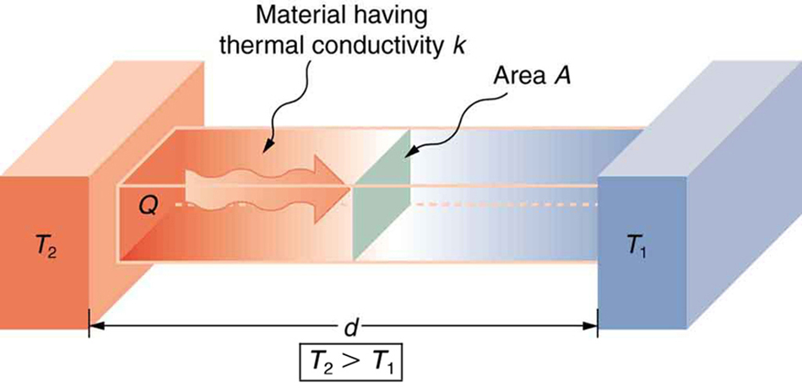
Heat and Heat Transfer
Effect of Thickness on Heat Conduction
Heat conduction occurs through any material, represented here by a rectangular bar. The temperature of the material is T2 on the left and T1 on the right, where T2 is greater than T1. The rate of heat transfer by conduction is directly proportional to the surface area A, the temperature difference T2−T1, and the substance's conductivity k. The rate of heat transfer is inversely proportional to the thickness d.
Free to share, print, make copies and changes. Get yours at www.boundless.com
OpenStax CNX. "OpenStax College, College Physics. October 15, 2012." CC BY 3.0 http://cnx.org/content/m42228/latest/?collection=col11406/1.7 View on Boundless.com

Slide 29
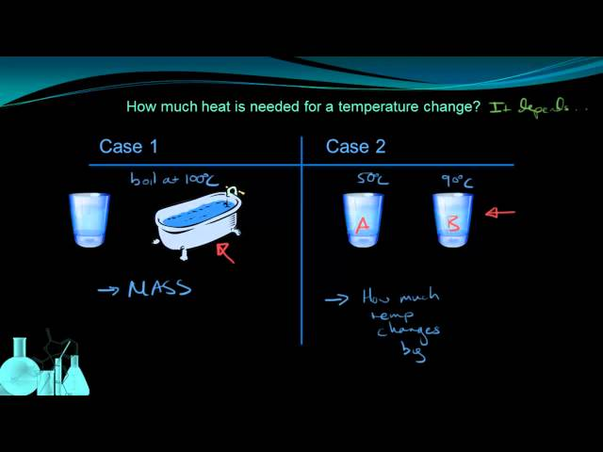
Heat and Heat Transfer
Specific Heat Capacity
This lesson relates heat to a change in temperature. We discuss how the amount of heat needed for a temperature change is dependent on mass and the substance involved, and that relationship is represented by the specific heat capactiy of the substance, C.
Free to share, print, make copies and changes. Get yours at www.boundless.com
View on Boundless.com

Slide 30
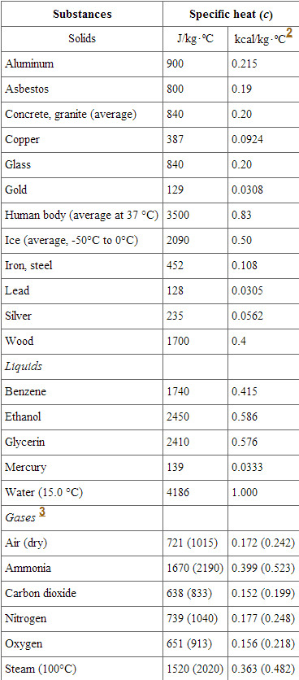
Heat and Heat Transfer
Specific Heats
Listed are the specific heats of various substances. These values are identical in units of cal/(g⋅C).3. cv at constant volume and at 20.0ºC, except as noted, and at 1.00 atm average pressure. Values in parentheses are cp at a constant pressure of 1.00 atm.
Free to share, print, make copies and changes. Get yours at www.boundless.com
OpenStax CNX. "OpenStax College, College Physics. October 14, 2012." CC BY 3.0 http://cnx.org/content/m42224/latest/?collection=col11406/1.7 View on Boundless.com

Slide 31
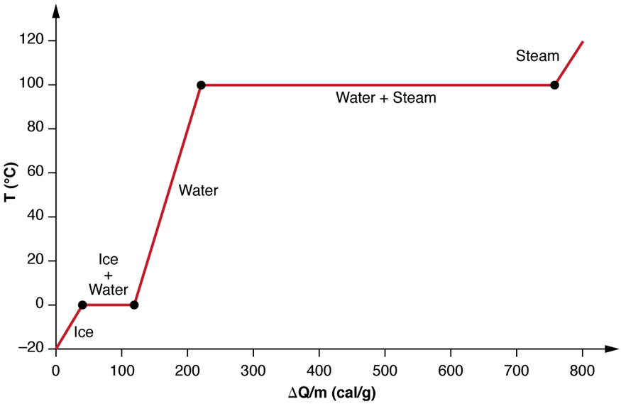
Heat and Heat Transfer
Heating and Phase Changes of Water
A graph of temperature versus energy added. The system is constructed so that no vapor evaporates while ice warms to become liquid water, and so that, when vaporization occurs, the vapor remains in of the system. The long stretches of constant temperature values at 0ºC and 100ºC reflect the large latent heat of melting and vaporization, respectively.
Free to share, print, make copies and changes. Get yours at www.boundless.com
OpenStax CNX. "OpenStax College, College Physics. October 15, 2012." CC BY 3.0 http://cnx.org/content/m42225/latest/?collection=col11406/1.7 View on Boundless.com

Slide 32
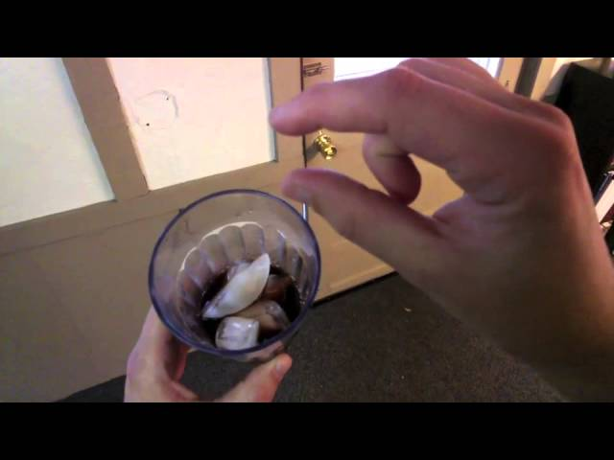
Heat and Heat Transfer
Heating Up Ice
Andrew Vanden Heuvel explores latent heat while trying to cool down his soda.
Free to share, print, make copies and changes. Get yours at www.boundless.com
View on Boundless.com

Slide 33
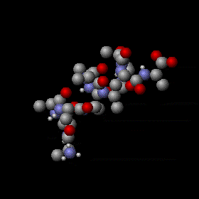
Heat and Heat Transfer
Molecular internal vibrations
When a gas is heated, translational kientic energy of molecules in the gas will increase. In addition, molecules in the gas may pick up many characteristic internal vibrations. Potential energy stored in these internal degrees of freedom contributes to specific heat of the gas.
Free to share, print, make copies and changes. Get yours at www.boundless.com
Wikipedia. "Thermally Agitated Molecule." CC BY-SA http://en.wikipedia.org/wiki/File:Thermally_Agitated_Molecule.gif View on Boundless.com

Slide 34
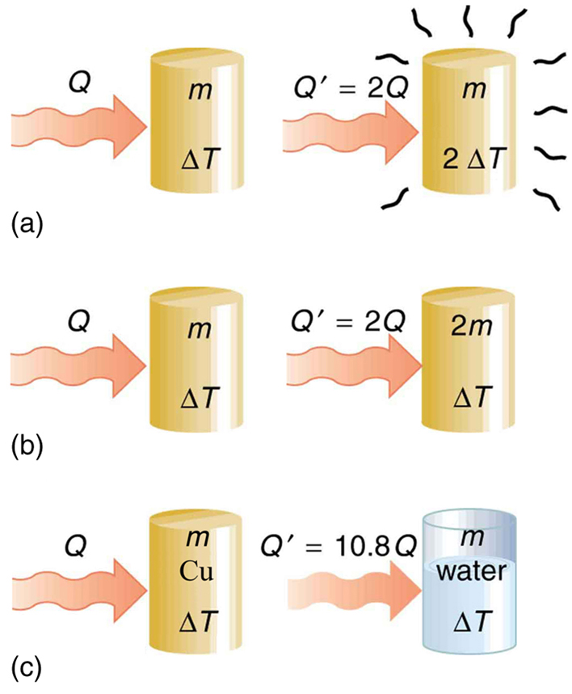
Heat and Heat Transfer
Heat Transfer and Specific Heat Capacity
The heat Q transferred to cause a temperature change depends on the magnitude of the temperature change, the mass of the system, and the substance and phase involved. (a) The amount of heat transferred is directly proportional to the temperature change. To double the temperature change of a mass m, you need to add twice the heat. (b) The amount of heat transferred is also directly proportional to the mass. To cause an equivalent temperature change in a doubled mass, you need to add twice the heat. (c) The amount of heat transferred depends on the substance and its phase. If it takes an amount Q of heat to cause a temperature change ΔT in a given mass of copper, it will take 10.8 times that amount of heat to cause the equivalent temperature change in the same mass of water assuming no phase change in either substance.
Free to share, print, make copies and changes. Get yours at www.boundless.com
OpenStax CNX. "OpenStax College, College Physics. October 14, 2012." CC BY 3.0 http://cnx.org/content/m42224/latest/?collection=col11406/1.7 View on Boundless.com

Slide 35
Heat and Heat Transfer
Microscopic Illustration of Conduction
he molecules in two bodies at different temperatures have different average kinetic energies. Collisions occurring at the contact surface tend to transfer energy from high-temperature regions to low-temperature regions. In this illustration, a molecule in the lower temperature region (right side) has low energy before collision, but its energy increases after colliding with the contact surface. In contrast, a molecule in the higher temperature region (left side) has high energy before collision, but its energy decreases after colliding with the contact surface.
Free to share, print, make copies and changes. Get yours at www.boundless.com
OpenStax CNX. "OpenStax College, College Physics. October 15, 2012." CC BY 3.0 http://cnx.org/content/m42228/latest/?collection=col11406/1.7 View on Boundless.com

Slide 36
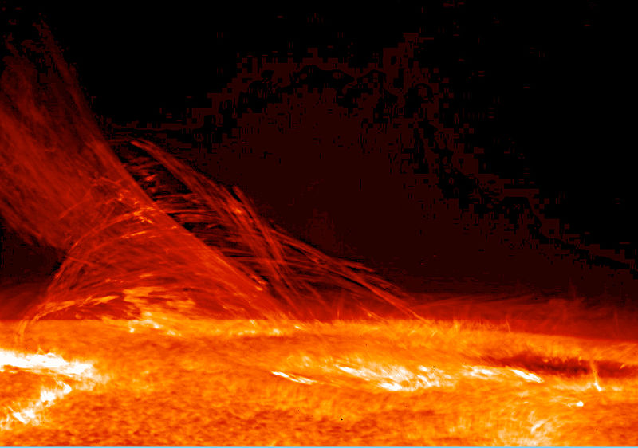
Heat and Heat Transfer
The Sun and Internal Energy
Nuclear fusion in the sun converts nuclear potential energy into available internal energy and keeps the temperature of the Sun very high.
Free to share, print, make copies and changes. Get yours at www.boundless.com
Wikipedia. "Heat." Public domain http://en.wikipedia.org/wiki/Heat View on Boundless.com

Slide 37
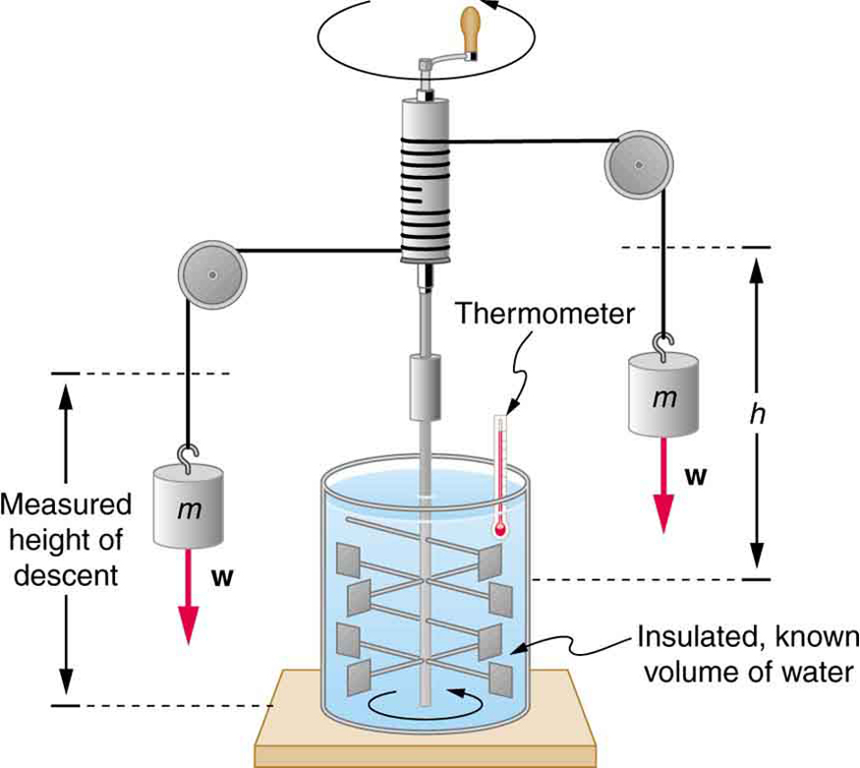
Heat and Heat Transfer
Figure 1 Equivalence of Heat and Work
Schematic depiction of Joule's experiment that established the equivalence of heat and work
Free to share, print, make copies and changes. Get yours at www.boundless.com
OpenStax CNX. "OpenStax College, College Physics. October 13, 2012." CC BY 3.0 http://cnx.org/content/m42223/latest/?collection=col11406/1.7 View on Boundless.com

Slide 38
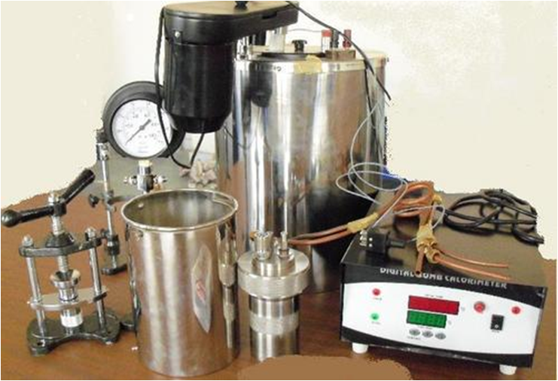
Heat and Heat Transfer
Bomb Calorimeter
This is the picture of a typical setup of bomb calorimeter.
Free to share, print, make copies and changes. Get yours at www.boundless.com
Wikimedia. "Bomb Calorimeter." CC BY-SA http://commons.wikimedia.org/wiki/File:Bomb_Calorimeter.png View on Boundless.com

Slide 39
Heat and Heat Transfer
The greenhouse effect
A summary of the heat transfer in the Earth's atmosphere.
Free to share, print, make copies and changes. Get yours at www.boundless.com
Wikipedia. "Greenhouse effect." GNU FDL http://en.wikipedia.org/wiki/Greenhouse_effect View on Boundless.com

Slide 40
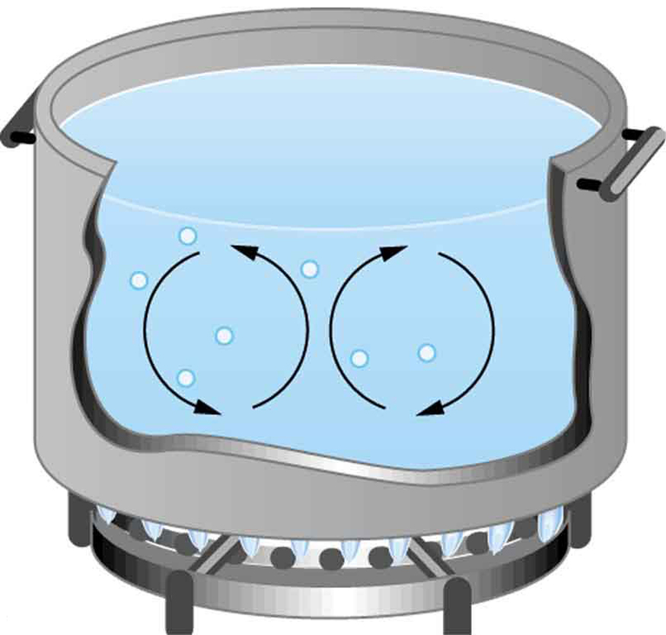
Heat and Heat Transfer
Convection in a Pot of Water
Convection plays an important role in heat transfer inside this pot of water. Once conducted to the inside, heat transfer to other parts of the pot is mostly by convection. The hotter water expands, decreases in density, and rises to transfer heat to other regions of the water, while colder water sinks to the bottom. This process keeps repeating.
Free to share, print, make copies and changes. Get yours at www.boundless.com
OpenStax CNX. "OpenStax College, College Physics. October 15, 2012." CC BY 3.0 http://cnx.org/content/m42229/latest/?collection=col11406/1.7 View on Boundless.com

Slide 41
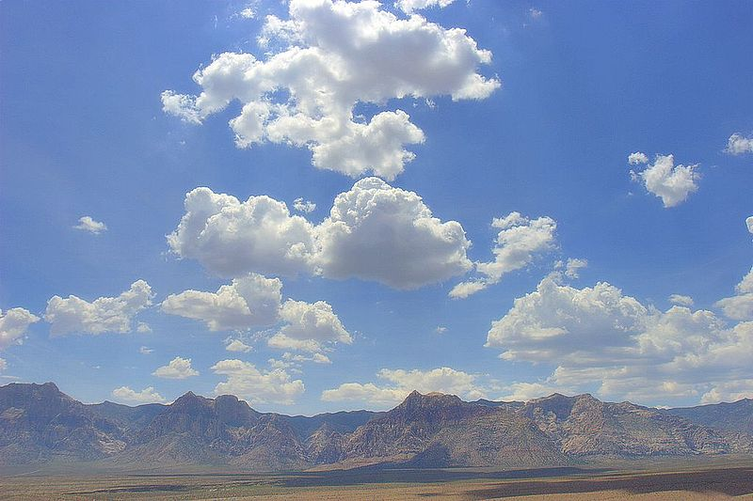
Heat and Heat Transfer
http://en.wikipedia.org/wiki/Cumulus_clouds
Cumulus clouds are caused by water vapor that rises because of convection. The rise of clouds is driven by a positive feedback mechanism.
Free to share, print, make copies and changes. Get yours at www.boundless.com
Wikipedia. "Cumulus clouds." GNU FDL http://en.wikipedia.org/wiki/Cumulus_clouds View on Boundless.com

Slide 42
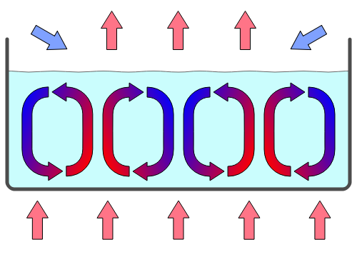
Heat and Heat Transfer
Convection Cells
Convection cells in a gravity field.
Free to share, print, make copies and changes. Get yours at www.boundless.com
Wikipedia. "Convection." GNU FDL http://en.wikipedia.org/wiki/Convection View on Boundless.com

Slide 43
Heat and Heat Transfer
Where Is the Most Heat Lost?
Use movable thermometers to discover where a house has poor insulation.
Free to share, print, make copies and changes. Get yours at www.boundless.com
View on Boundless.com

Slide 44
Attribution
Heat and Heat Transfer
Wiktionary. "greenhouse gas." CC BY-SA 3.0 http://en.wiktionary.org/wiki/greenhouse_gas
Wiktionary. "greenhouse effect." CC BY-SA 3.0 http://en.wiktionary.org/wiki/greenhouse_effect
Wiktionary. "radiative transfer." CC BY-SA 3.0 http://en.wiktionary.org/wiki/radiative_transfer
Cornell University Library. "[0903.4603] Evolution and the second law of thermodynamics." CC BY http://arxiv.org/abs/0903.4603
Wikipedia. "Radiative transfer." CC BY-SA 3.0 http://en.wikipedia.org/wiki/Radiative_transfer
National Air and Space Association. "Aerosols: Tiny Particles, Big Impact : Feature Articles." CC BY-SA http://earthobservatory.nasa.gov/Features/Aerosols/page3.php
Wikipedia. "Greenhouse effect." CC BY-SA 3.0 http://en.wikipedia.org/wiki/Greenhouse_effect
Intergovernmental Panel on Climate Change. "TS.2.1 Greenhouse Gases - AR4 WGI Technical Summary." CC BY-SA http://www.ipcc.ch/publications_and_data/ar4/wg1/en/tssts-2-1.html
Wiktionary. "emissivity." CC BY-SA 3.0 http://en.wiktionary.org/wiki/emissivity
Wiktionary. "blackbody." CC BY-SA 3.0 http://en.wiktionary.org/wiki/blackbody
OpenStax CNX. "OpenStax College, College Physics. September 17, 2013." CC BY 3.0 http://cnx.org/content/m42230/latest/?collection=col11406/1.7
Wikipedia. "constant-pressure calorimeter." CC BY-SA 3.0 http://en.wikipedia.org/wiki/constant-pressure%20calorimeter
Boundless Learning. "Boundless." CC BY-SA 3.0 http://www.boundless.com//physics/definition/constant-volume-calorimeter
Wiktionary. "calorimeter." CC BY-SA 3.0 http://en.wiktionary.org/wiki/calorimeter
Wikipedia. "Calorimetry." CC BY-SA 3.0 http://en.wikipedia.org/wiki/Calorimetry
Wikipedia. "Calorimeter." CC BY-SA 3.0 http://en.wikipedia.org/wiki/Calorimeter
Wiktionary. "positive feedback." CC BY-SA 3.0 http://en.wiktionary.org/wiki/positive_feedback
Free to share, print, make copies and changes. Get yours at www.boundless.com

Slide 45
Heat and Heat Transfer
Wikipedia. "natural convection." CC BY-SA 3.0 http://en.wikipedia.org/wiki/natural%20convection
OpenStax CNX. "OpenStax College, College Physics. September 17, 2013." CC BY 3.0 http://cnx.org/content/m42226/latest/?collection=col11406/1.7
Wikipedia. "Convection." CC BY-SA 3.0 http://en.wikipedia.org/wiki/Convection
OpenStax CNX. "OpenStax College, College Physics. September 17, 2013." CC BY 3.0 http://cnx.org/content/m42229/latest/?collection=col11406/1.7
Wiktionary. "specific heat." CC BY-SA 3.0 http://en.wiktionary.org/wiki/specific_heat
Wikipedia. "adiabatic index." CC BY-SA 3.0 http://en.wikipedia.org/wiki/adiabatic%20index
Wikipedia. "Fundamental Thermodynamic Relation." CC BY-SA 3.0 http://en.wikipedia.org/wiki/Fundamental%20Thermodynamic%20Relation
Wikipedia. "Julius Robert von Mayer." CC BY-SA 3.0 http://en.wikipedia.org/wiki/Julius_Robert_von_Mayer
Wikipedia. "Specific heat." CC BY-SA 3.0 http://en.wikipedia.org/wiki/Specific_heat
Wikipedia. "Relations between heat capacities." CC BY-SA 3.0 http://en.wikipedia.org/wiki/Relations_between_heat_capacities
Wikipedia. "Ideal gas." CC BY-SA 3.0 http://en.wikipedia.org/wiki/Ideal_gas
Wikipedia. "Vaporization." CC BY-SA 3.0 http://en.wikipedia.org/wiki/Vaporization
Wikipedia. "Evaporation." CC BY-SA 3.0 http://en.wikipedia.org/wiki/Evaporation
Wiktionary. "heat transfer." CC BY-SA 3.0 http://en.wiktionary.org/wiki/heat_transfer
Wiktionary. "calorimetry." CC BY-SA 3.0 http://en.wiktionary.org/wiki/calorimetry
OpenStax CNX. "OpenStax College, College Physics. September 17, 2013." CC BY 3.0 http://cnx.org/content/m42226/latest/?collection=col11406/1.7
OpenStax CNX. "OpenStax College, College Physics. September 17, 2013." CC BY 3.0 http://cnx.org/content/m42221/latest/?collection=col11406/1.7
OpenStax CNX. "OpenStax College, College Physics. September 17, 2013." CC BY 3.0 http://cnx.org/content/m42226/latest/?collection=col11406/1.7
Wikipedia. "Heat." CC BY-SA 3.0 http://en.wikipedia.org/wiki/Heat
Free to share, print, make copies and changes. Get yours at www.boundless.com

Slide 46
Heat and Heat Transfer
OpenStax CNX. "OpenStax College, College Physics. September 17, 2013." CC BY 3.0 http://cnx.org/content/m42223/latest/?collection=col11406/1.7
Wiktionary. "isolated system." CC BY-SA 3.0 http://en.wiktionary.org/wiki/isolated_system
Boundless Learning. "Boundless." CC BY-SA 3.0 http://www.boundless.com//physics/definition/internal-energy
Wikipedia. "Internal energy." CC BY-SA 3.0 http://en.wikipedia.org/wiki/Internal_energy
Wiktionary. "heat capacity." CC BY-SA 3.0 http://en.wiktionary.org/wiki/heat_capacity
Wiktionary. "enthalpy." CC BY-SA 3.0 http://en.wiktionary.org/wiki/enthalpy
Wikipedia. "Heat capacity." CC BY-SA 3.0 http://en.wikipedia.org/wiki/Heat_capacity
Boundless Learning. "Boundless." CC BY-SA 3.0 http://www.boundless.com//physics/definition/mechanical-equivalent-of-heat
Wiktionary. "kilocalorie." CC BY-SA 3.0 http://en.wiktionary.org/wiki/kilocalorie
Boundless Learning. "Boundless." CC BY-SA 3.0 http://www.boundless.com//physics/definition/thermal-equilibrium--2
OpenStax CNX. "OpenStax College, College Physics. September 18, 2013." CC BY 3.0 http://cnx.org/content/m42223/latest/?collection=col11406/1.7
Wikipedia. "Heat." CC BY-SA 3.0 http://en.wikipedia.org/wiki/Heat
Wiktionary. "specific heat capacity." CC BY-SA 3.0 http://en.wiktionary.org/wiki/specific_heat_capacity
Wikipedia. "Heat capacity." CC BY-SA 3.0 http://en.wikipedia.org/wiki/Heat_capacity
OpenStax CNX. "OpenStax College, College Physics. September 18, 2013." CC BY 3.0 http://cnx.org/content/m42224/latest/?collection=col11406/1.7
OpenStax CNX. "OpenStax College, Chemistry. October 13, 2015." CC BY 4.0 http://cnx.org/contents/85abf193-2bd2-4908-8563-90b8a7ac8df6@9.110
Wiktionary. "combustion." CC BY-SA 3.0 http://en.wiktionary.org/wiki/combustion
Wikipedia. "Calorimetry." CC BY-SA 3.0 http://en.wikipedia.org/wiki/Calorimetry
Wiktionary. "equilibrium." CC BY-SA 3.0 http://en.wiktionary.org/wiki/equilibrium
Free to share, print, make copies and changes. Get yours at www.boundless.com

Slide 47
Heat and Heat Transfer
Wiktionary. "condensation." CC BY-SA 3.0 http://en.wiktionary.org/wiki/condensation
Wikipedia. "Evaporation." CC BY-SA 3.0 http://en.wikipedia.org/wiki/Evaporation
Wikipedia. "Phase (matter)." CC BY-SA 3.0 http://en.wikipedia.org/wiki/Phase_(matter)%23Phase_equilibrium
Wikipedia. "Earth's atmosphere." CC BY-SA 3.0 http://en.wikipedia.org/wiki/Earth's_atmosphere
Wiktionary. "sublimation." CC BY-SA 3.0 http://en.wiktionary.org/wiki/sublimation
Boundless Learning. "Boundless." CC BY-SA 3.0 http://www.boundless.com//physics/definition/latent-heat-of-vaporization
Boundless Learning. "Boundless." CC BY-SA 3.0 http://www.boundless.com//physics/definition/latent-heat-of-fusion
OpenStax CNX. "OpenStax College, College Physics. September 18, 2013." CC BY 3.0 http://cnx.org/content/m42225/latest/?collection=col11406/1.7
Wikipedia. "Latent heat." CC BY-SA 3.0 http://en.wikipedia.org/wiki/Latent_heat
Wikipedia. "thermal conductivity." CC BY-SA 3.0 http://en.wikipedia.org/wiki/thermal%20conductivity
Wikipedia. "Conduction (heat)." CC BY-SA 3.0 http://en.wikipedia.org/wiki/Conduction_(heat)
OpenStax CNX. "OpenStax College, College Physics. September 18, 2013." CC BY 3.0 http://cnx.org/content/m42228/latest/?collection=col11406/1.7
OpenStax CNX. "OpenStax College, College Physics. September 18, 2013." CC BY 3.0 http://cnx.org/content/m42226/latest/?collection=col11406/1.7
Free to share, print, make copies and changes. Get yours at www.boundless.com

